Slide 1
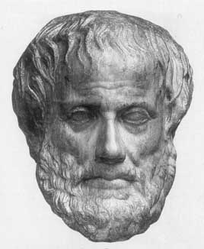
Lecture 4:
Knowledge Representation and Reasoning
Junfeng Yao
Xiamen University
Slides used in the classroom only

Slide 2
Lecture overview
Artificial Intelligence
4. Knowledge Representation

Slide 3
Report: Robots ready for Super Bowl kickoff
Arizona law enforcement agencies will use robots to help maintain security at the Super Bowl to be held Feb. 3 at the University of Phoenix Stadium.
The robots will assist officers on patrol in a two-square-mile security zone around the stadium. They will assist the Phoenix and Glendale, Ariz. Police departments as well as other federal, state and local agencies at the game.
“We're here to support the event and hopefully go unnoticed by fans. Our job isn't to be a disruption but to keep danger at a distance," said Mack Barber, president of Remotec, an operating unit of Northrop Grumman's Mission Systems sector.

Slide 4
Robots ready for Super Bowl kickoff …
The robots are about 3 feet high and move on wheels. Some will be in the public view and possibly patrolling with officers, and some will be in enclosed areas and only brought out if they are needed, said Northrop Grumman spokesman George Seffers.
Northrop Grumman builds robots for handling hazardous materials and other risky jobs. The robots typically help fire and police departments with explosive disposal units and hazardous material cleanup.

Slide 5
Explicit Knowledge Representation
What is knowledge?
What applications do you know of knowledge?
Where do we not need knowledge?
How do we use knowledge?

Slide 6
Function of Knowledge Representation
The function of any representation scheme is to capture the essential features of a problem domain and make that information accessible to a problem-solving procedure.

Slide 7
Function of Knowledge Representation
Expressiveness and efficiency are major dimensions for evaluating knowledge representation languages.
Optimizing the trade-off is a major task for designers of intelligent systems.
Example: Different representations of the real number π.

Slide 8
A Representation Scheme should:
Be adequate to express all of the necessary information
Support efficient execution of the resulting code.
Provide a natural scheme for expressing the required knowledge.

Slide 9
AI Representation Languages must:
Handle qualitative knowledge
Allow new knowledge to be inferred from a basic set of facts
Allow representation of general principles as well as specific situations
Capture complex semantic meaning
Allow for meta-level reasoning (meta-knowledge)

Slide 10
Knowledge in Different Forms
CYC, OpenMind, SUMO – Commonsense
CYC - A massive ongoing effort to formalize common-sense knowledge. An open source version is now available as OpenCyc, including (parts of) the ontology, axioms, inference engine, and knowledge acquisition tools
SUMO----the Suggested Upper Merged Ontology
Ontologies – frame-based, semantic web
Medical knowledge
Diseases/symptoms networks
Dynamic systems
Specific applications: NLP, Databases

Slide 11
Knowledge Representation and Reasoning (KR&R)
Advice taker: a paradigm for KR&R
  Represent knowledge (with statements)
  Add statements when you want to give advice (control knowledge = statements)
  World vs Reasoner (Decision Maker)
Reasoner
+
Knowledge
Actions/Decisions
World
Sensory
information

Slide 12
Knowledge Representation and Reasoning (KR&R)
Advice taker: a paradigm for KR&R
Examples:
  A robot moving and manipulating the world
  An internet agent booking flights for us
  A virtual agent in a computer game
Reasoner
+
Knowledge
Actions/Decisions
World
Sensory
information

Slide 13
Reasoning Tasks
A robot moving and manipulating the world
  Track the environment and its body (actions)
  Update its knowledge with new information (sensors & communications)
  Make timely decisions
  Safe decisions
  Take uncertainty into account
  Learning and generalizing from knowledge

Slide 14
Example
A robot moving and manipulating the world
Reasoning
Algorithm
Reasoner
+
Knowledge
Actions/Decisions
World
KB
Tasks
Mngr
Sensory
information
Symbols to
Sensors

Slide 15
Example Details 1
A robot moving and manipulating the world
Reasoning
Algorithm
Reasoning
Algorithm
Task: Decide on action
Call reasoning algorithm
with query. Examples:
- next_action(move_fwd)
- next_action(look_door)
KB
KB
Tasks
Mngr
Tasks
Mngr
Symbols to
Sensors
Symbols to
Sensors

Slide 16
Example Details 2
A robot moving and manipulating the world
Reasoning
Algorithm
Task: Is the action safe?
Call reasoning algorithm
with query. Examples:
- safe_action(move_fwd)
- safe_action(look_door,s)
KB
Tasks
Mngr
Symbols to
Sensors

Slide 17
Example Details 3
A robot moving and manipulating the world
Reasoning
Algorithm
Task: Track the world
Use reasoning to update
knowledge. Examples:
get_KB(result(move_fwd))
get_KB(result(arm(10),s))
KB
Tasks
Mngr
Symbols to
Sensors

Slide 18
Example Use of Reasoning 1
Task: select an action to perform
Logical KB:
  (a) Prove that KB entails move_fwd (e.g.,FOL)
  (b) Find a model of KB that satisfies move_fwd (e.g., propositional logic)
Probabilistic KB:
  Find the probability of move_fwd (e.g., BNs)
  Find an action that gives best utility (MDPs)

Slide 19
Example Use of Reasoning 2
Task: find cause of error Err
Logical KB:
  Abduction: Find an explanation Exp such that KB ∧ Exp logically entails Err
Probabilistic KB:
  Find the set of variable assignments that has maximum posterior probability given Err

Slide 20
Knowledge Representation and Reasoning (KR&R)
Two agents interacting
  Sales and purchase agent
  Collaboration to achieve a task
  Information agent and user agent
Reasoning Agent 1
+
Knowledge Base 1
Request
Agent 2
+
Knowledge Base 2
Response

Slide 21
Knowledge Representation and Reasoning (KR&R)
Query answering:
  Formal verification of digital circuits
  Temporal verification of programs
  Prediction and explanation
Human / Software
Query
Reasoning with
A Knowledge Base
Answer

Slide 22
Tractability of Reasoning
More expressive languages require more time to reason with
Expressivity – Tractability tradeoff
Compact representations not always more efficient for reasoning
Reasoning with a complete model many times easier than reasoning with general knowledge in the same language

Slide 23
Summary: Why, When, How KR&R
Reasoning with knowledge is good when we are not sure about knowledge or query.
The language of KB is determined by the application:
  Need for expressive language
  Need for fast/accurate response
Knowledge is entered by hand or learned
Tasks for reasoning algorithms vary

Slide 24
Representation Representation Representation
Think about knowledge, rather than data in AI
Facts
Procedures
Meaning
  Cannot have intelligence without knowledge
Always been very important in AI
Choosing the wrong representation
  Could lead to a project failing
Still a lot of work done on representation issues

Slide 25
Representation
Knowledge Representation Languages
  Logic: propositional, First-Order Logic(FOL), Description Logics [, defaults, linear logic]
  Probabilities: graphical models (e.g., BNs), relational-probabilistic models [, causality]
Specific cases:
  Dynamic worlds: logical, probabilistic
  Space/Shape: logical, probabilistic
  Knowledge about knowledge

Slide 26
Reasoning
Exact inference:
  Fundamental principles
  Structure: treewidth [, context-based]
Approximate inference:
  Sampling, variational, lower/upper bounds,…
Special tasks:
  Dynamic worlds: filtering, smoothing,…
  Space/Shape: logical, probabilistic
  Equality

Slide 27
Representations for
Problem solving techniques
For certain problem solving techniques
  The “best” representation has already been worked out
  Often it is an obvious requirement of the technique
  Or a requirement of the programming language (e.g., Prolog)
Examples:
  First order theorem proving (first order logic)
  Inductive logic programming (logic programs)
  Neural networks learning (neural networks)
But what if you have a new project?
  What kind of general representations schemes are there?

Slide 28
Five General Representation Types
Logical Representations
Semantic Networks
Production Rules
Frames
Ontologies

Slide 29
Rules for knowledge Representation
RULES
IF a person P complains of symptom S
AND drug D relieves symptom S
THEN person P should take drug D
FACTS
GLOBAL
aspirin relieves headache
LOCAL
john complains of headache

Slide 30
REASONING with RULES
involves forward and backward chaining through rules
forward: data driven
backward: goal driven

Slide 31
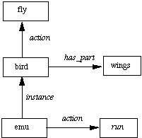
Knowledge Rep: Semantic Nets

Slide 32
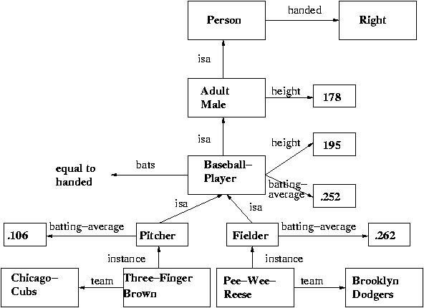
Semantic Nets

Slide 33
Knowledge Rep: Semantic Nets
nodes are objects or concepts
arcs are relations
Reasoning involves graph search and graph sub-graph matching

Slide 34
4.1 Logical Representations
What is a Logic?
Lay down some concrete communication rules
  In order to give information to agents, and get info
    Without errors in communication (or at least, fewer)
Think of a logic as a language
  Many ways to translate from one language to another
Expressiveness
  How much of natural language (e.g., English)
    We are able to translate into the logical language
Not to be confused with logical reasoning
  “Sherlock Holmes used pure logic to solve that…”
  This is a process, not a language

Slide 35
Syntax and Semantics of Logics
Syntax
  How we can construct legal sentences in the logic
  Which symbols we can use (English: letters, punctuation)
  How we are allowed to write down those symbols
Semantics
  How we interpret (read) sentences in the logic
  i.e., what the meaning of a sentence is
Example: “All lecturers are six foot tall”
  Perfectly valid sentence (syntax)
  And we can understand the meaning (semantics)
  This sentence happens to be false (there is a counterexample)

Slide 36
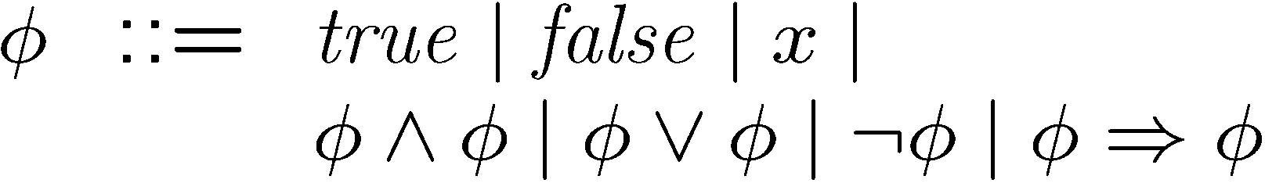
Propositional logic
Simple and easy to understand
Decidable, but NP complete
  Very well studied; efficient SAT(Satisfiability) solvers
  if you can reduce your problem to SAT …
Drawback
  can only model finite domains

Slide 37
Propositional Logic
Syntax
  Propositions such as P meaning “it is wet”
  Connectives: and, or, not, implies, equivalent
  Brackets, T (true) and F (false)
Semantics
  How to work out the truth of a sentence
    Need to know how connectives affect truth
    E.g., “P and Q” is true if and only if P is true and Q is true
    “P implies Q” is true if P and Q are true or if P is false
  Can draw up truth tables to work out the truth of statements

Slide 38




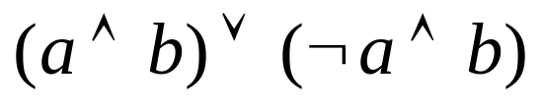
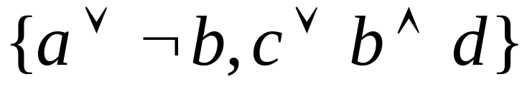
Propositional Logic
Language includes
  Prop. symbols
  Logical connectives
Formulas:
  Atom
  Literal
  Formula
KB: Set of formulas

Slide 39
Representing Knowledge
Propositional symbols represent facts under consideration:
  there_is_rain, there_are_clouds, door1_open, robot_in_pos_56_210
Not propositions:
  is_there_rain?
  location_of_robot
  Dan_Roth

Slide 40
Representing Knowledge
Knowledge bases are sets of formulae
  There_is_rain → there_are_clouds
  Robot_in_pos_3_1 → ¬Position_3_1_empty
  Has_drink → coffee ∨ tea

Slide 41
Knowledge Engineering
Select a language: set of features
Examine cases
Decide on dependencies between features
Write dependencies formally
Test

Slide 42
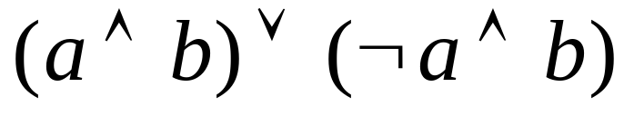
Propositional Logic
Semantics:
  Truth assignments that satisfy KB/formula
I₁
-a | -b
a | -b
-a | b
a | b
I₂
I₃
I₄
Interpretations: I₁[a]=FALSE I₁[b]=FALSE
assign truth values to propositional symbols

Slide 43
Propositional Logic
Semantics:
  Truth assignments that satisfy KB/formula
I₁
-a
-b
M₁
╨
I₂
a
-b
M₁= I₃
-a
b
M₂= I₄
a
b
Models of f: Interpretations that satisfy f

Slide 44

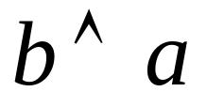

Propositional Logic
Semantics:
  Truth assignments that satisfy KB/formula
Logical
Entailment
M₁
╨
╨
╨
╨
╨

Slide 45
Propositional Logic
Semantics:
  Truth assignments that satisfy KB/formula
Logical
Entailment
╨
Deduction
(inference)
┴

Slide 46
More Notations
Interpretations ~ Models
Axioms – formulae that are “assumed”
Signature – the symbols used by a KB
Theory ~ KB (a set of axioms), or
Theory ~ the complete set of sentences entailed by the axioms
Sentence = formula (in prop. logic)

Slide 47
More Notations
The value that symbol p takes in model M:
  [[ M ]] _{p}
  p^{M}
  M[p] -- we will primarily use this
Clauses: {lit1, lit2, lit3,…} or lit1∨ lit2∨ lit3...

Slide 48
Summary
Propositional logic as a language for representing knowledge
Did not touch on reasoning procedures
Defined language, signature, models
What are the limitations of propositional logic?

Slide 49
First Order Predicate Logic (FOL)
More expressive logic than propositional
  And one we will use a lot in this course
    Later lecture all about first order predicate logic
Syntax allows
  Constants, variables, predicates, functions and quantifiers
So, we say something is true for all objects (universal)
  Or something is true for at least one object (existential)
Semantics
  Working out the truth of statement
    This can be done using rules of deduction

Slide 50
Example:
Translating English to FOL
Every gardener likes the sun.
(Ax) gardener(x) => likes(x,Sun)
You can fool some of the people all of the time.
(Ex) (person(x) ^ (At)(time(t) => can-fool(x,t)))
You can fool all of the people some of the time.
(Ax) (person(x) => (Et) (time(t) ^ can-fool(x,t)))
All purple mushrooms are poisonous.
(Ax) (mushroom(x) ^ purple(x)) => poisonous(x)
No purple mushroom is poisonous.
~(Ex) purple(x) ^ mushroom(x) ^ poisonous(x)
or, equivalently,
(Ax) (mushroom(x) ^ purple(x)) => ~poisonous(x)
There are exactly two purple mushrooms.
(Ex)(Ey) mushroom(x) ^ purple(x) ^ mushroom(y) ^ purple(y) ^ ~(x=y) ^ (Az) (mushroom(z) ^ purple(z)) => ((x=z) v (y=z))
Deb is not tall.
~tall(Deb)
X is above Y if X is on directly on top of Y or else there is a pile of one or more other objects directly on top of one another starting with X and ending with Y.
(Ax)(Ay) above(x,y) <=> (on(x,y) v (Ez) (on(x,z) ^ above(z,y)))

Slide 51
Example Sentence
In English:
“Every Monday and Wednesday I go to John’s house for dinner”
In first order predicate logic:
X ((day_of_week(X, monday)
day_of_week(X, weds))
(go_to(me, house_of(john)
eat(me, dinner))).
Note the change from “and” to “or”
  Translating is problematic

Slide 52
Inadequacy of first order logic
They are monotonic: More information one has, more consequences one gets.
Human communication is typically based on closed world assumption.

Slide 53
An Example of Closed World Assumption
ground-wet ← watering.
ground-wet ← raining.
In an open world, there could be others that cause ground-wet (we simply don’t know, or have not said).
But in a closed world, what we said is all that we know, for Horn clauses, this is called Clark Completion,
Ground-wet ⇔ watering ∨ raining

Slide 54
Logics
Standard logics
  Propositional logic
  First-order predicate logic
  Higher-order predicate logic
Non-standard logics
  Categorical logic, Combinatory logic, Conditional logic, Constructive logic, Cumulative logic, Deontic logic, Dynamic logic, Epistemic logic, Erotetic logic, Free logic, Fuzzy logic, Infinitary logic, Intensional logic, Intuitionistic logic, Linear logic, Many-valued logic, Modal logic, Non-monotonic logic, Paraconsistent logic, Partial logic, Prohairetic logic, Quantum logic, Relevant logic, Stoic logic, Substance logic, Substructural logic, Temporal (tense) logic
  In short: a lot!

Slide 55
Logic has three purposes
It is used to express the problem at hand
It is used by the theorem prover for automated reasoning
It is used to communicate with the end user of the theorem prover

Slide 56
This leads to three questions
How expressive is the logic?
  what problems can be expressed in the logic
How automatable is the logic?
  how much can we hope to automate reasoning in the logic
How human-friendly is the logic?
  for proofs and/or counter-examples
  for interactive theorem proving
We will look at some logics, with these three questions in mind

Slide 57
Other Logics
Fuzzy logic
  Use probabilities, rather than truth values
Multi-valued logics
  Assertions other than true and false allowed
    E.g., “unknown”
Modal logics
  Include beliefs about the world
Temporal logics
  Incorporate considerations of time

Slide 58
Why Logic is a Good Representation
Some of many reasons are:
  It’s fairly easy to do the translation when possible
  There are whole tracts of mathematics devoted to it
  It enables us to do logical reasoning
  Programming languages have grown out of logics
    Prolog uses logic programs (a subset of predicate logic)

Slide 59
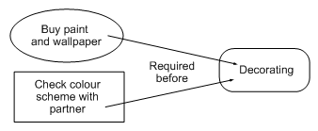

Graphical Representations
Logic is not the only fruit
Humans draw diagrams all the time, e.g.,
  E.g. causal relationships:
  And relationships between ideas:

Slide 60
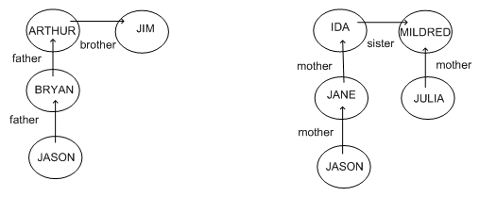
Graphical Representations
Graphs are very easy to store inside a computer
For information to be of any use
  We must impose a formalism on the graphs
  Jason is 15, Bryan is 40, Arthur is 70, Jim is 74
  How old is Julia?

Slide 61
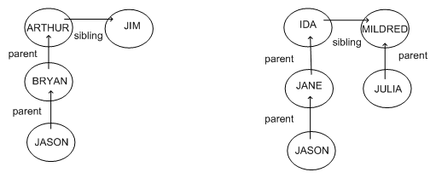
Better Graphical Representation
Because the formalism is the same
  We can guess that Julia’s age is similar to Bryan’s
Limited the syntax to impose formalism

Slide 62
Semantic Network Formalisms
Used a lot for natural language understanding
  Represent two sentences by graphs
    Sentences with same meaning have exactly same graphs
Conceptual Dependency Theory
  Roger Schank’s brainchild
  Concepts are nodes, relationships are edges
  Narrow down labels for edges to a very few possibilities
  Problem:
    Not clear whether reduction to graphs can be automated for all sentences in a natural language

Slide 63
Conceptual Graphs
Each graph represents a single proposition
Concept nodes can be:
  Concrete (visualisable) such as restaurant, my dog spot
  Abstract (not easily visualisable) such as anger
Edges do not have labels
  Instead, we introduce conceptual relation nodes
Many other considerations in the formalism
  See Russell and Norvig for details

Slide 64
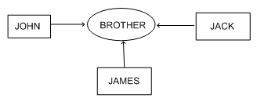
Example Conceptual Graph
Advantage:
  Single relationship between multiple concepts is easily representable

Slide 65
Production Rule Representations
Consists of <condition,action> pairs
Agent checks if a condition holds
  If so, the production rule “fires” and the action is carried out
  This is a recognize-act cycle
Given a new situation (state)
  Multiple production rules will fire at once
  Call this the conflict set
  Agent must choose from this set
    Call this conflict resolution
Production system is any agent
  Which performs using recognize-act cycles

Slide 66
Example Production Rule
As reported in Doug Lenat’s PhD thesis
102. After creating a new generalization G of Concept C
  Consider looking for non-examples of G
This was paraphrased
  In general, we have to be more concrete
    About exactly when to fire and what to do

Slide 67
Frame Representations
Information retrieval when facing a new situation
  The information is stored in frames with slots
  Some of the slots trigger actions, causing new situations
Frames are templates
  Which are to be filled-in in a situation
  Filling them in causes an agent to
    Undertake actions and retrieve other frames
Frames are extensions of record datatype in databases
  Also very similar to objects in OOP

Slide 68
Flexibility in Frames
Slots in a frame can contain
  Information for choosing a frame in a situation
  Relationships between this and other frames
  Procedures to carry out after various slots filled
  Default information to use where input is missing
  Blank slots - left blank unless required for a task
  Other frames, which gives a hierarchy

Slide 69
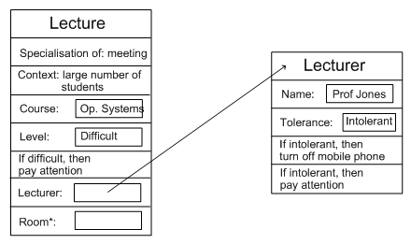
Example Frame

Slide 70


Questions & Suggestions?
The End

Slide 71
Supplement
Show some examples of encoding problems in first order logic (in preparation for the mini-project)
Look at two examples of uses of theorem provers:
  ESC/Java
  Rhodium

Slide 72
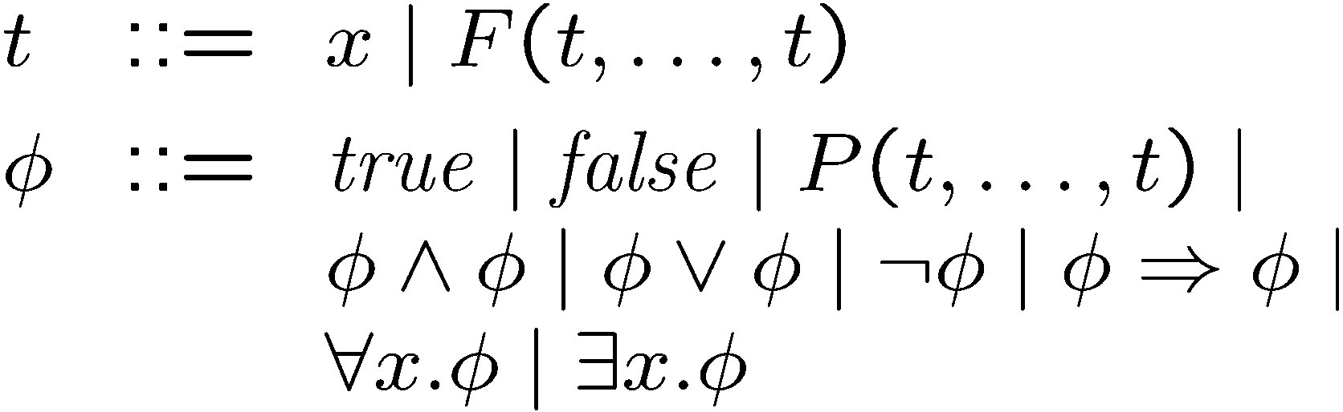
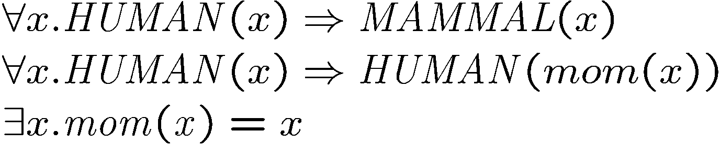
First-order logic
Example:

Slide 73
First-order logic: sources of “infinities”
Function symbols can be applied a finite but an unbounded number of times
Is this a different source of infinity than we’ve seen so far?
Answer: no. This infinity (unboundedness) is reflected through the infinite domains
  In the above case, the Herbrand universe is infinite
  May or may not

Slide 74
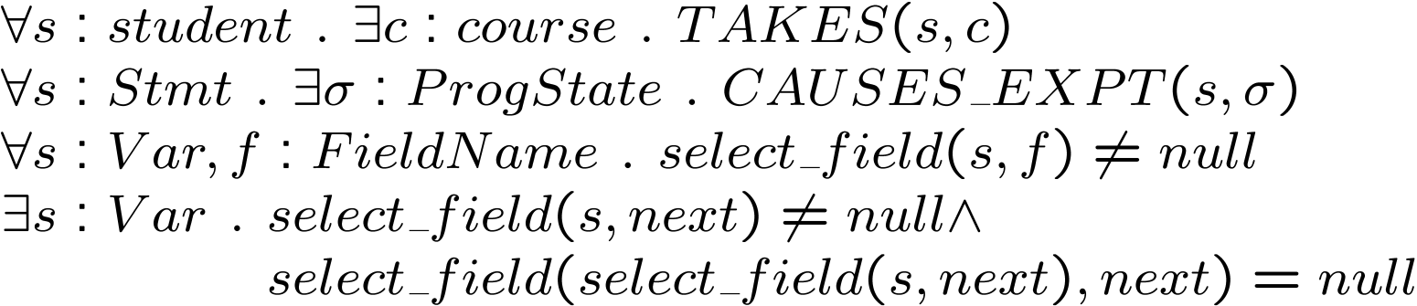
Many-sorted first-order logic
First-order logic with many sorts (types)
Not more expressive than first-order logic, but convenient for expressing formulas over domains that have complex structure
Types can be encoded in the untyped first-order logic

Slide 75
Summary of first-order logic
Expressiveness
  more expressive than propositional logic
  because of infinite domains
Automation
  not decidable anymore
  one of the main source of difficulty are quantifiers, not surpisingly
  still, very well studied, and many theorem provers and theorem proving techniques available

Slide 76
Summary of first-order logic
Human-friendliness
  Intuitive for humans to understand. Also, types, if present, improve readability
  One may choose FOL even if the problem is expressible in propositional logic, because of FOL’s notational conveniences and human friendliness.
  For example, even if domain is finite, it may be more intuitive to write a formula using first-order quantifiers, rather than propositional logic
  However, more expressive logics are generally less automatable: danger that a formula provable by a propositional engine will not be provable automatically when expressed using quantifiers

Slide 77
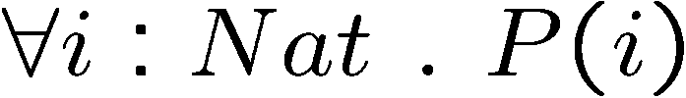

Limitations of first-order logic
Let’s look at proof by induction
To prove:
Show:
And:

Slide 78
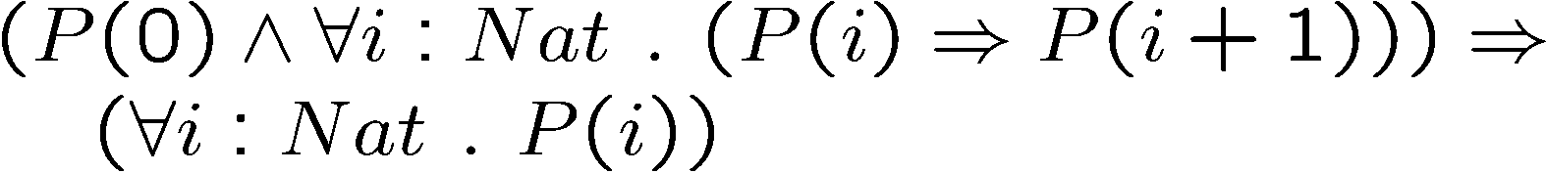
Let’s express this as a theorem

Slide 79

Let’s express this as a theorem

Slide 80
Let’s express this as a theorem
P needs to range over predicates…
In FOL, a variable was a term
  could only be passed to function symbols, or to predicate symbols.
A variable could not be applied as a predicate

Slide 81
Let’s express this as a theorem
Could use encoding tricks, for example:
  use app(P, x) to represent P(x)
However, this becomes cumbersome, and it also doesn’t provide all the expressiveness that quantifying over predicates does

Slide 82
Higher-order logic
In first-order logic
  quantifiers range over ground terms
  predicates only take terms as arguments
Higher-order logic also allows
  quantification over predicates
  predicates that take predicates as arguments

Slide 83
Expressiveness of higher-order logic
First-order logic + transitive closure
  strictly more expressive than first-order logic
  expressible in higher-order logic
Suppose you have a linked list L of finite, but unbounded size. You want to express the theorem “5 is in L”
Intuitively, next_{tc} computes the transitive closure of the next relation
  next_{tc}(L) returns the set of nodes reachable from L

Slide 84
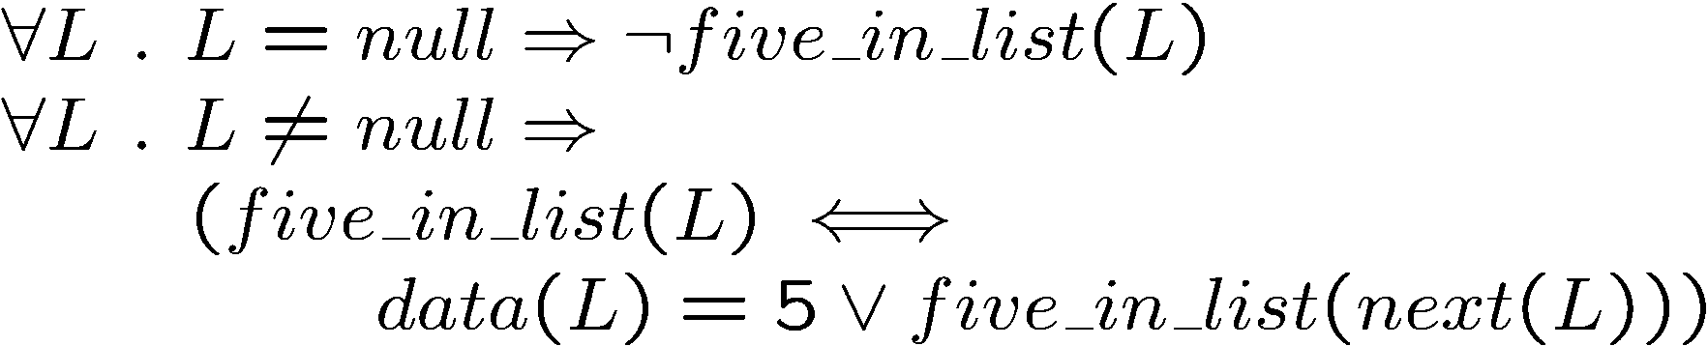
Expressiveness of higher-order logic
Let’s try doing this in first-order logic
This is a correct and complete encoding for finite-length lists

Slide 85




Expressiveness of higher-order logic
However, for infinite-length lists (for example cyclic lists), this encoding does not work
Consider a cyclic linked list with one node that points to itself, and suppose the data for that node is 0.
  We have and
  Since , the second axiom from the previous slide gives us:
  Thus we gain no information about

Slide 86
Expressiveness of higher-order logic
The transitive closure formulation works, even on infinite lists
Transitive closure is also very convenient for expressing heap properties
  for example: linked lists L₁ and L₂ are disjoint

Slide 87
Let’s go back to induction
Anxious student: Does this mean we can’t use induction in first-order logic?
No, we can still use induction, using an induciton inference rule
We just can’t reason about induction in first-order logic

Slide 88
Higher Order Predicate Logic
More expressive than first order predicate logic
Allows quantification over functions and predicates, as well as objects
For example
  We can say that all our polynomials have a zero at 17:
  f (f(17)=0).
Working at the meta-level
  Important to AI, but not often used

Slide 89
Summary of higher-order logics
More expressive than first-order logic
Even less automatable than first-order logic
  No theorem prover that I know of handles higher-order logic fully automatically

Slide 90
Summary of classical logics
prop ! FOL ! HOL
less expressive to more expressive
more automatable to less automatable
sometimes may choose more expressive logic, even if not strictly required
  LCF, HOL and Isabelle theorem prover

